Slide 1
Plant Identification

Slide 2
Overview
Plant identification is very difficult to do with Machine Learning
There are lots of different species of plants, with variations of each species
If doing photo identification, also have to account for the angle the image was taken
A model could think it’s a different plant
Thus, lots of data is needed in order to classify every species, including any variations in that species
Not feasible, but we can get close by gathering more data

Slide 3
The Dataset
Will be training with a dataset called PlantNet-300k
Over 300,000 images
Separate testing and validation data
1081 different species
Dataset has a strong class imbalance
A few species account for most of the images
Many of the species are visually similar, where identification can be difficult even for an expert
For our training however, we will use a shortened version of the dataset, with about 50 species, to save on training time

Slide 4
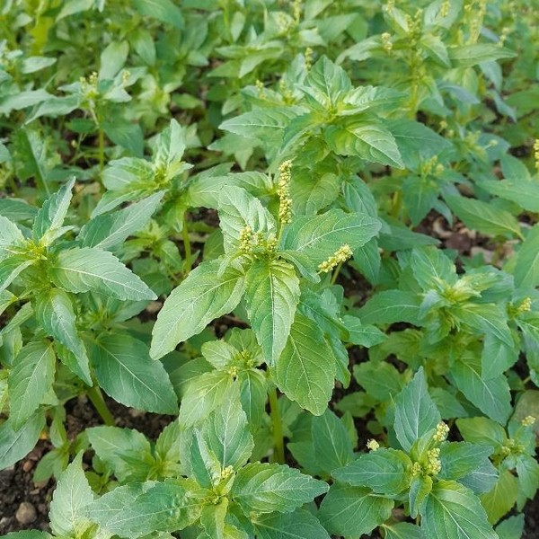
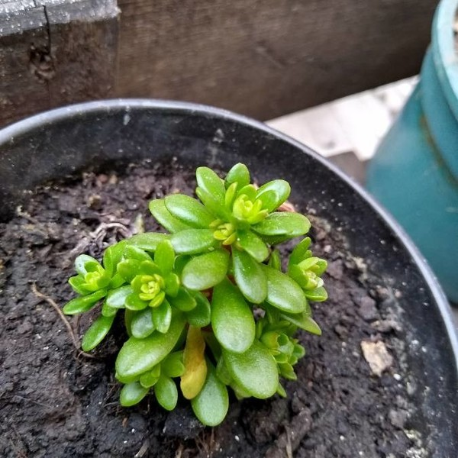
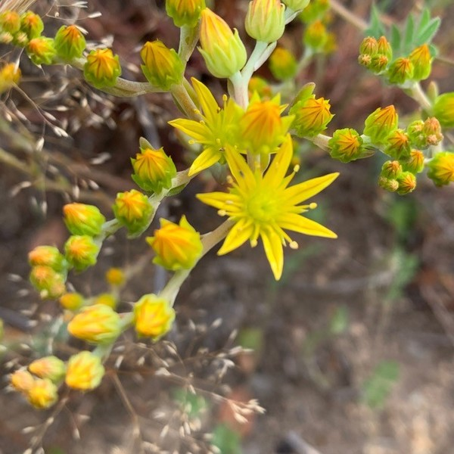
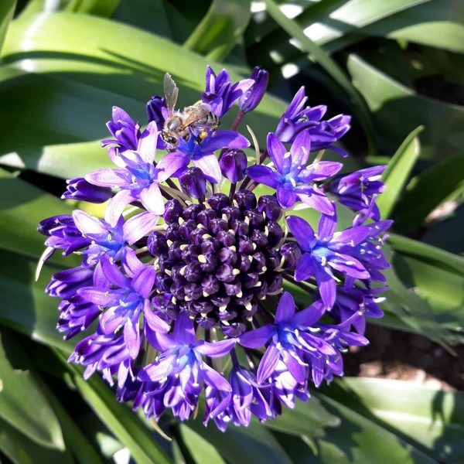
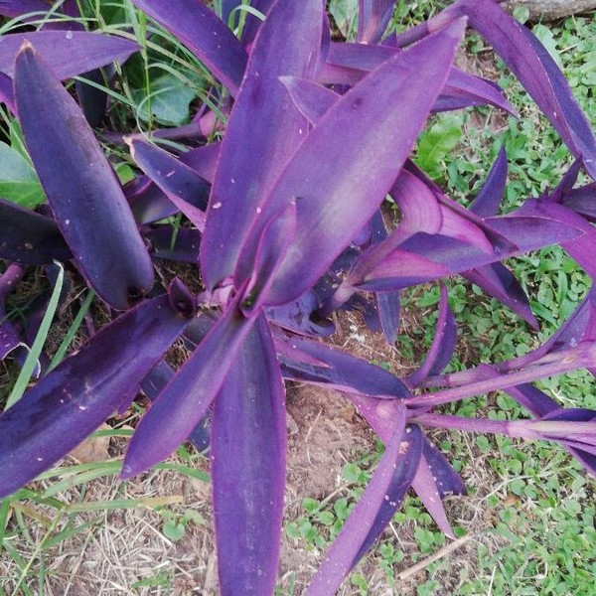
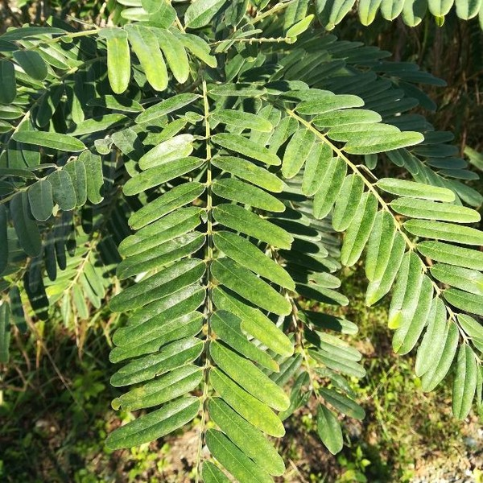
Example Images

Slide 5
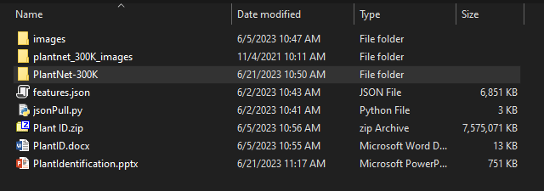
The Code
On the Desktop, double click on the “PlantID” folder to open it
Once the folder has opened, double click on the “PlantNet-300K” folder

Slide 6
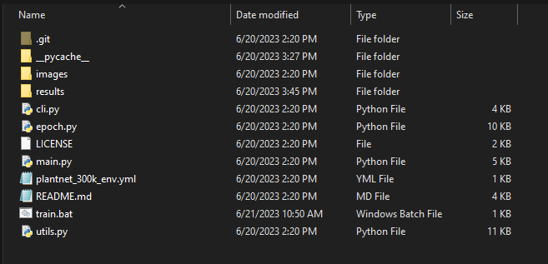
The Code
All of the code and execution files can be found in the “PlantNet-300K” folder

Slide 7
The Model
The model has already been pretrained
We are going to load the pretrained model and then do more training on those learned parameters
Fine Tuning the network weights
This is know as transfer learning
Taking the model that has been pretrained for a different task, training and fine tuning the model, and using the model for our data

Slide 8
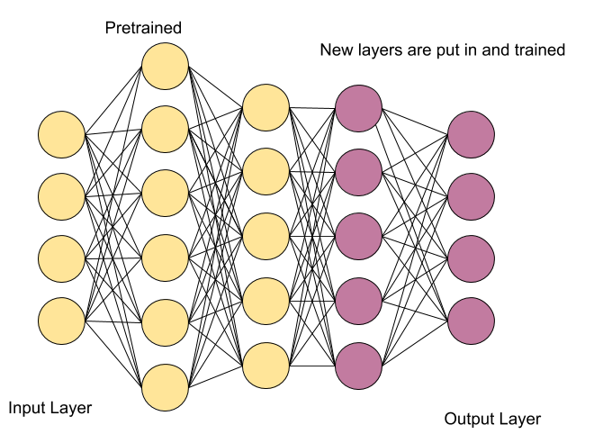
The Model

Slide 9
Main
Right click on the “main.py” file, click edit

Slide 10
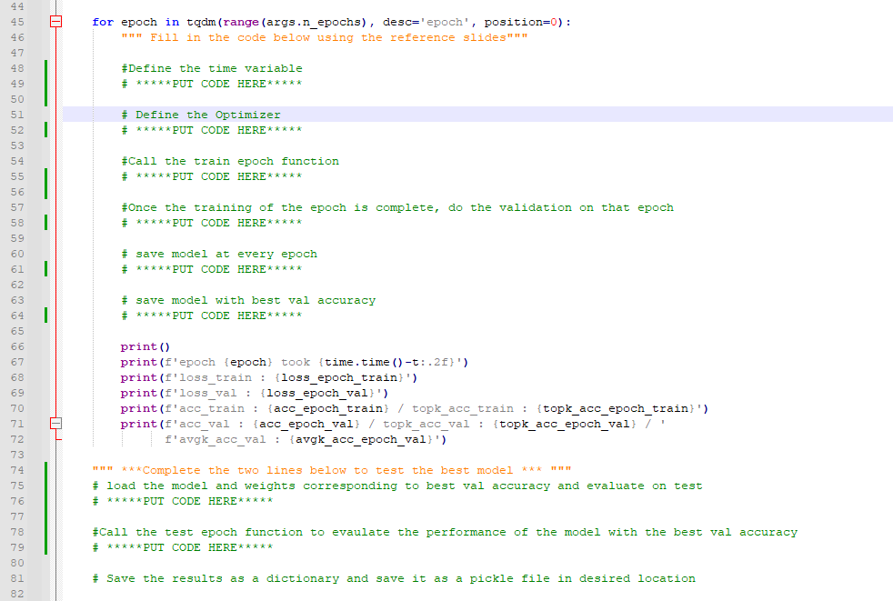
Main
Complete the code in the train function

Slide 11
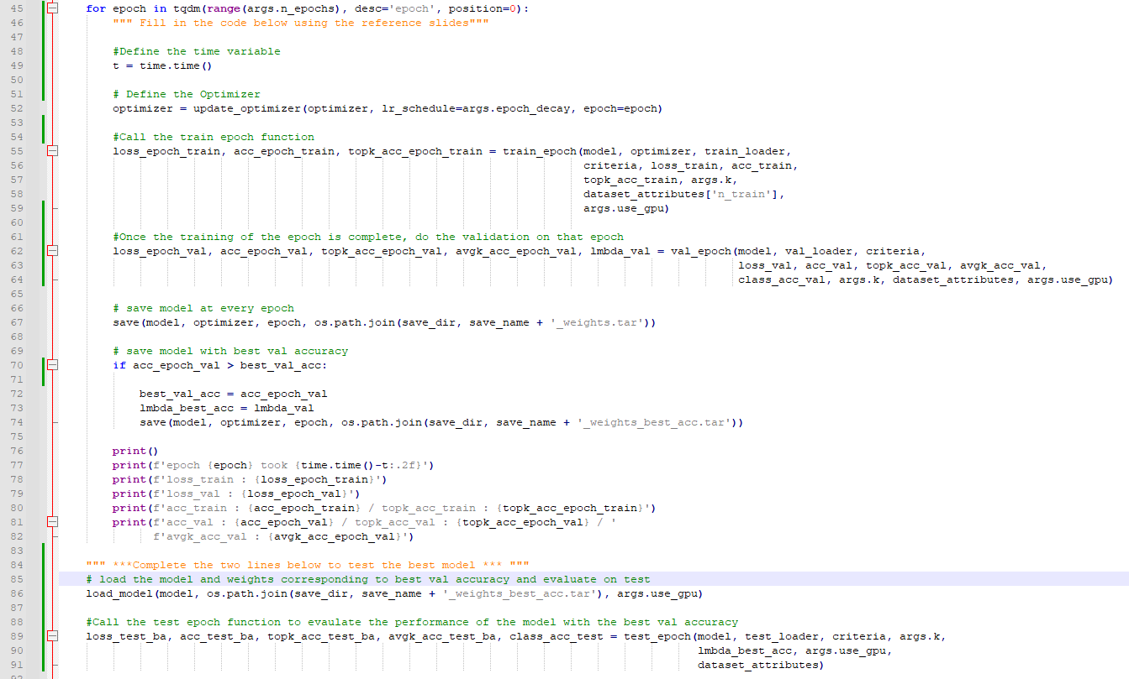
Main

Slide 12
Main
Once the code is complete, make sure to save the file
Close the Integrated Development Environment (IDE)

Slide 13
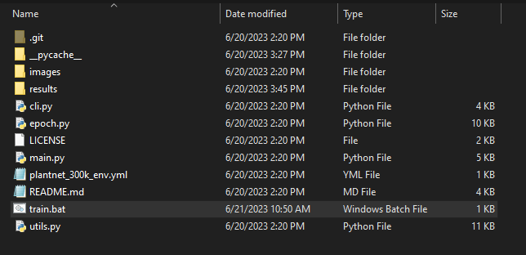
Execution Script
Right click on the “train.bat” file and click “Edit”

Slide 14
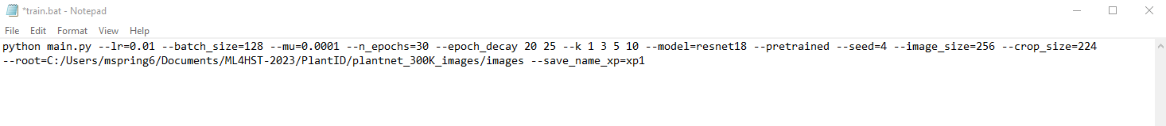
Execution Script
The file should look similar to the one shown below
The “root” section might need to be changed to point to the plant photo folder on the desktop
Save file if any changes were made

Slide 15
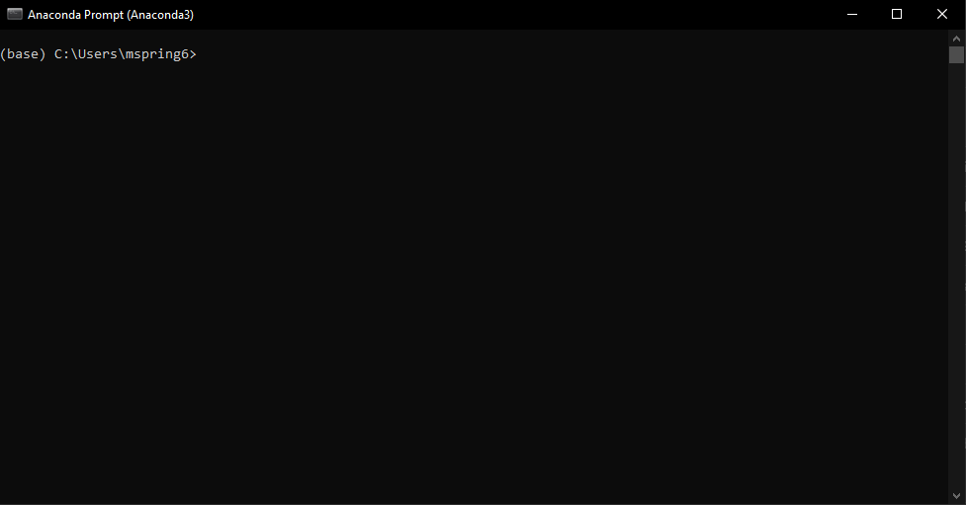
Execution Script
Click the windows icon at the bottom of your screen
Type in the search bar “Anaconda Prompt”

Slide 16
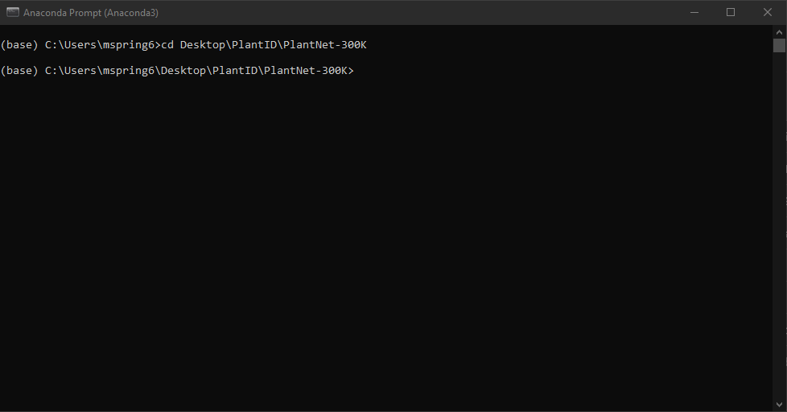
Execution Script
In the Anaconda Prompt, type “cd Desktop\PlantID\PlantNet-300K”

Slide 17
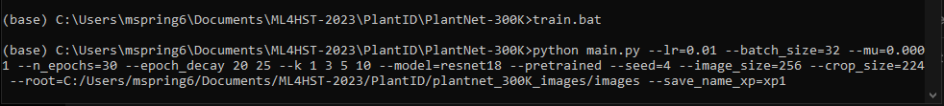
Execution Script
In the Anaconda Prompt, type “train.bat”

Slide 18
Training
Training will take some time to complete
In the mean time, we will move on to the Drone Data Collection and come back after the training has completed
Once the training is complete, DO NOT CLOSE THE ANACONDA PROMPT

Slide 19
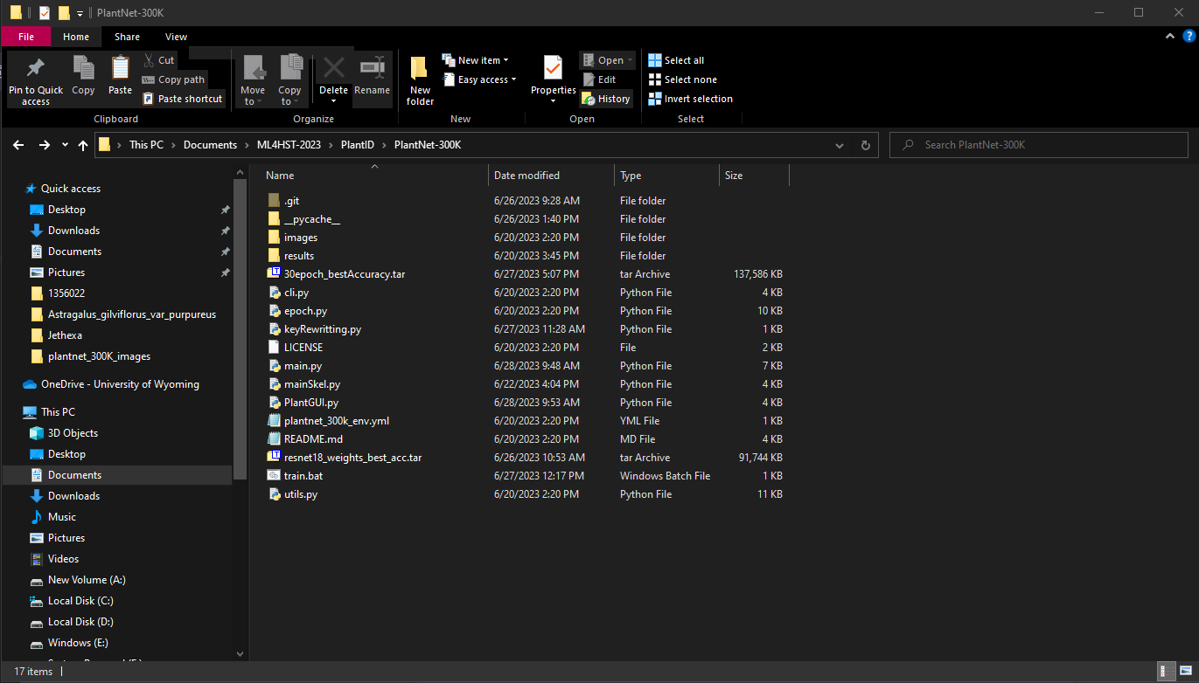
Model Evaluation
Open the folder where the code is located, and then double click on the “results” folder

Slide 20
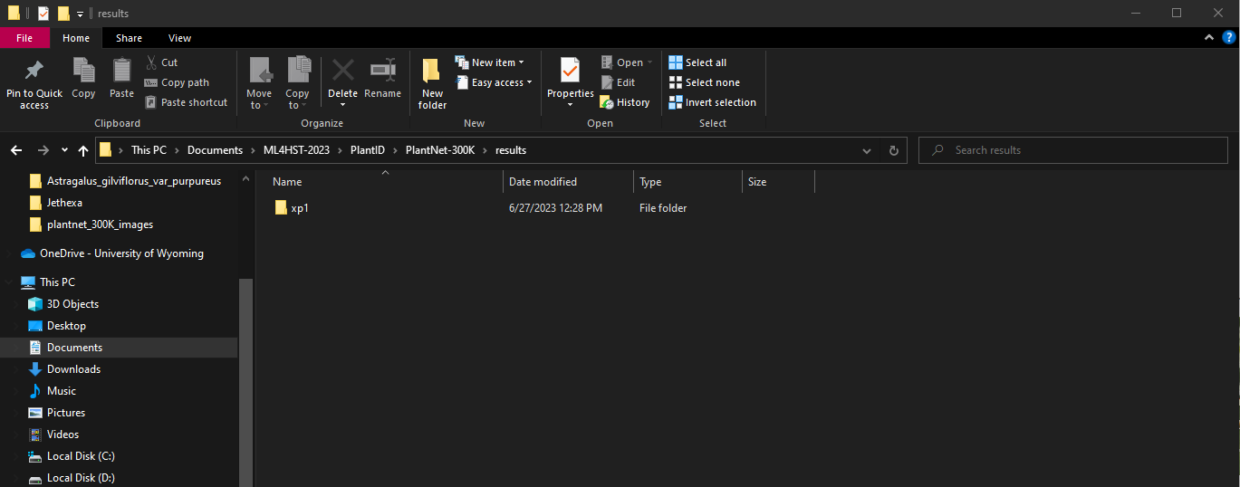
Model Evaluation
Then double click on the “xp1” folder

Slide 21
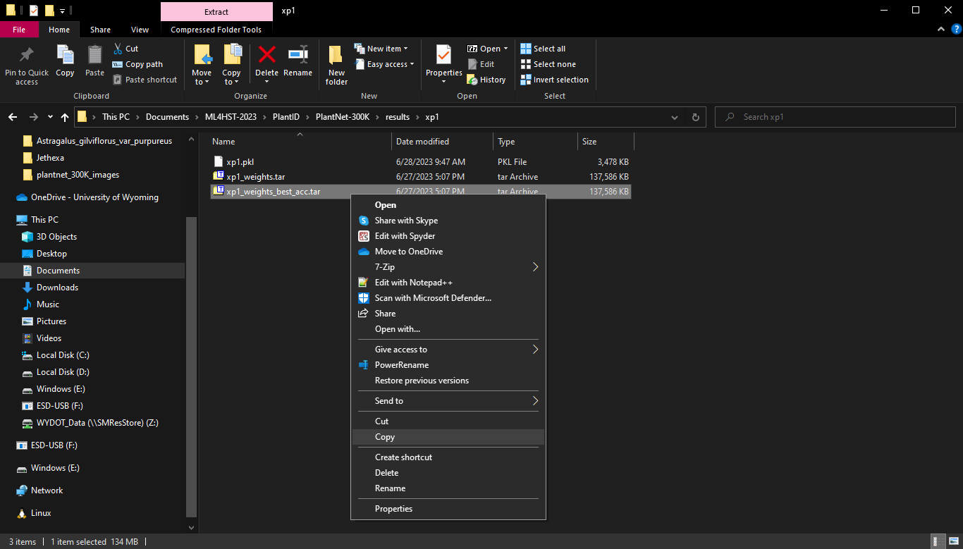
Model Evaluation
Right click on the “xp1_weight_best_acc.tar” file and click “copy”

Slide 22
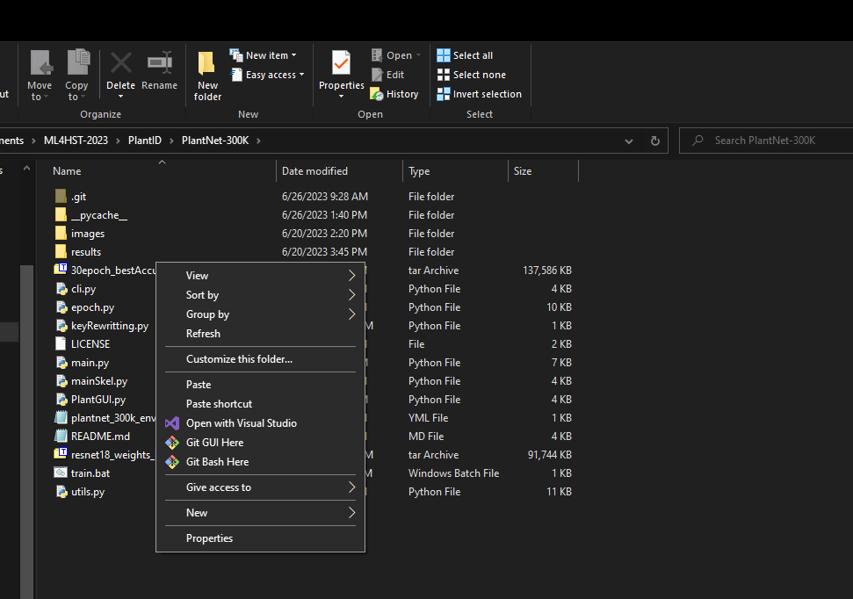
Model Evaluation
Go back to the main code folder and right click and paste

Slide 23
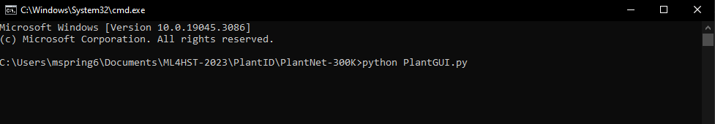
Model Evaluation
Go back to Anaconda Prompt and type the following
“python PlantGUI.py”
Then press enter

Slide 24
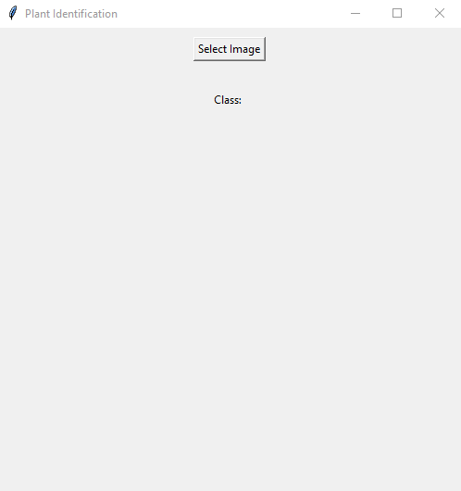
Model Evaluation
A GUI will then launch which is running your trained model and takes pictures as inputs

Slide 25
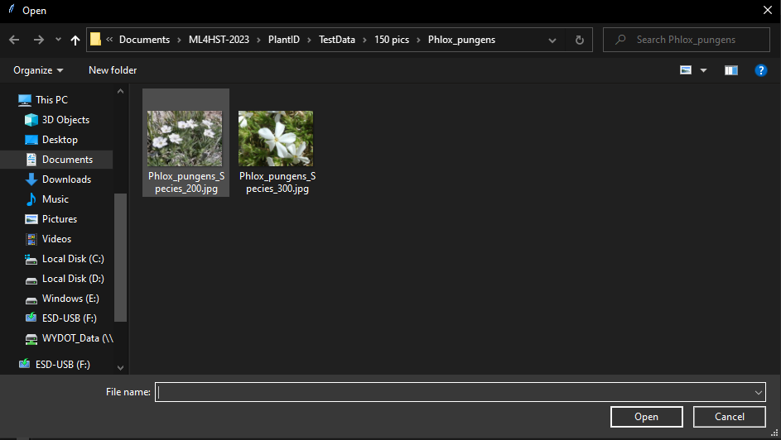
Model Evaluation
Click on “Select Image” button and then select one of the images you brought

Slide 26
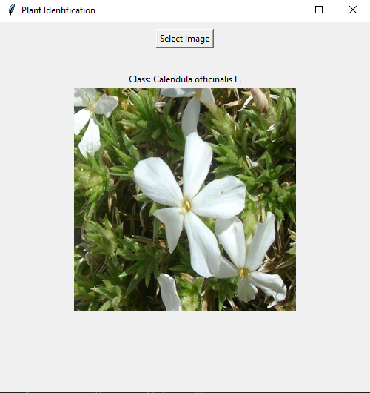
Model Evaluation
The GUI will then display the image and evaluate it with the model
Evaluate the model with all of the images you brought in and record what the class is
When done, close the GUI with the “X” in the corner

Slide 27
Problems with the model
We only trained with about 50 different plant species
Can’t account for every plant so a lot of the classifications will be wrong
We also didn’t train for very long, so the performance of the model will be worse

Slide 28
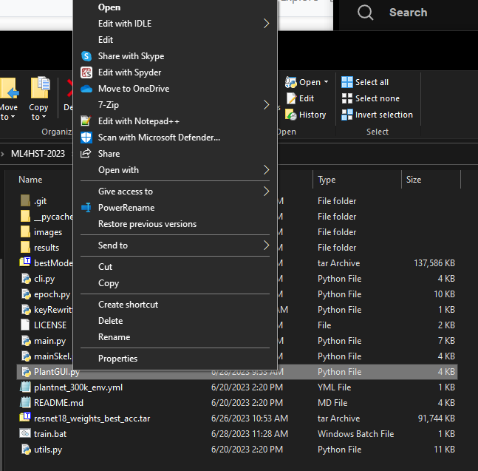
Pre trained model
The model was then trained with the full species list and trained for a lot longer
The model was also much more complex, with 50 layers
To test this model, right click on the “PlantGUI.py” file in the code folder and click edit

Slide 29
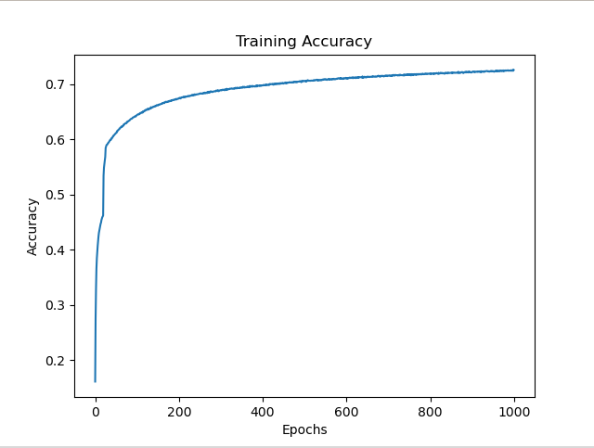
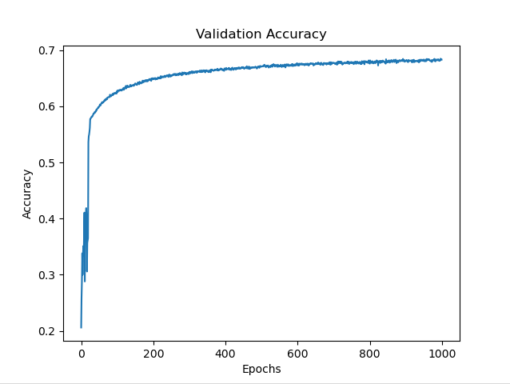
Pre trained model
This model was trained for 1000 epochs
It can be seen that the training and validation accuracy are very similar

Slide 30
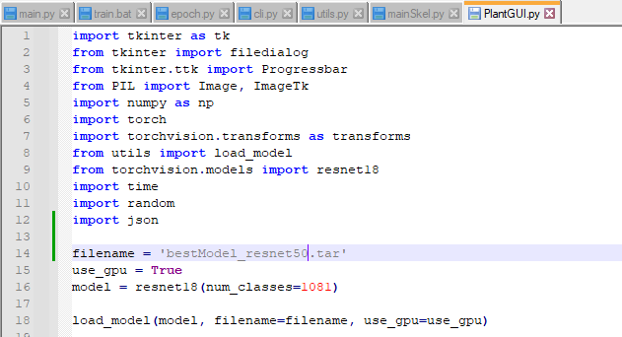
Pre trained model
Change line 14 to match what’s below
“filename = ‘bestModel_resnet50.tar’
Then save the file

Slide 31
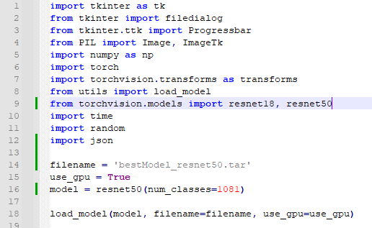
Pre trained model
Change line 16 to match what’s below
“model = resnet50(num_classes=1081)"
Then save the file

Slide 32
Pre trained model
Back in the Anaconda Prompt, run the GUI file again
“python PlantGUI.py”

Slide 33
Pre trained model
Play around in the GUI again and test all of the images you brought in and note down what classification each image is
Did the model classify more images correctly?

Slide 34
PlantNet
The PlantNet-300K dataset is only a small portion of the total data that PlantNet has
Their total dataset has over 14.7 million images, accounting for 37,499 species of plant
They don’t release this full dataset, but have a pretrained model on their app and website that is free to use
https://plantnet.org/en/#download

Slide 35
PlantNet
Navigate to the PlantNet Identify webpage
https://plantnet.org/en/#download

Slide 36
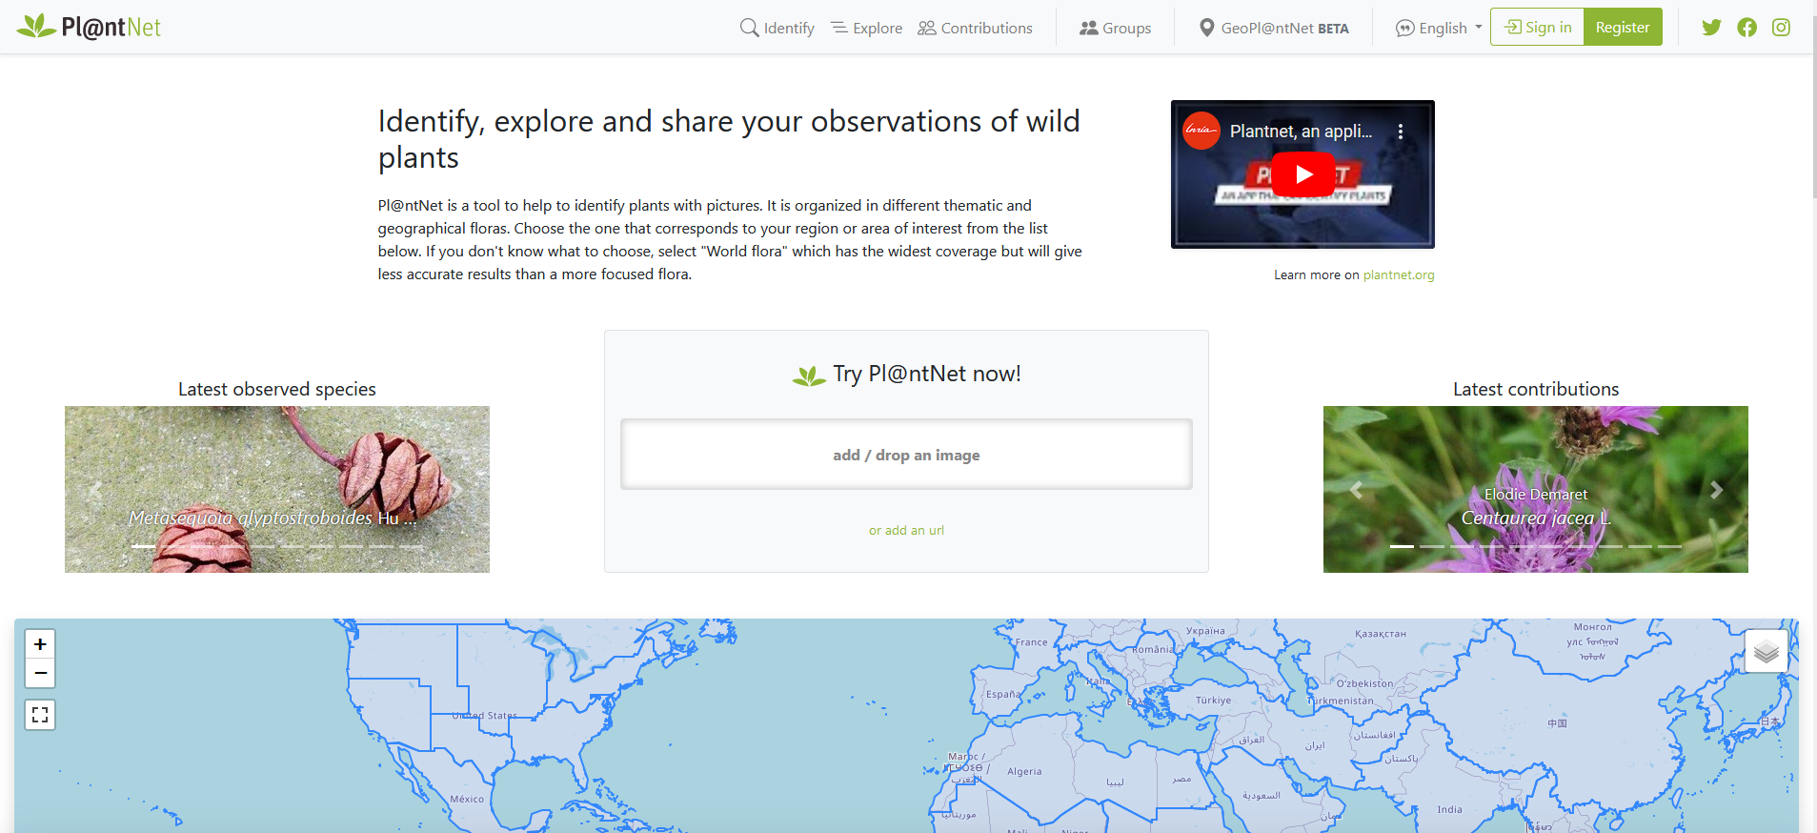
PlantNet
In the center of the screen, there is an upload button to upload any images you have of plants you want to identify

Slide 37
PlantNet
Click the upload button and upload one of the images you brought to the workshop

Slide 38
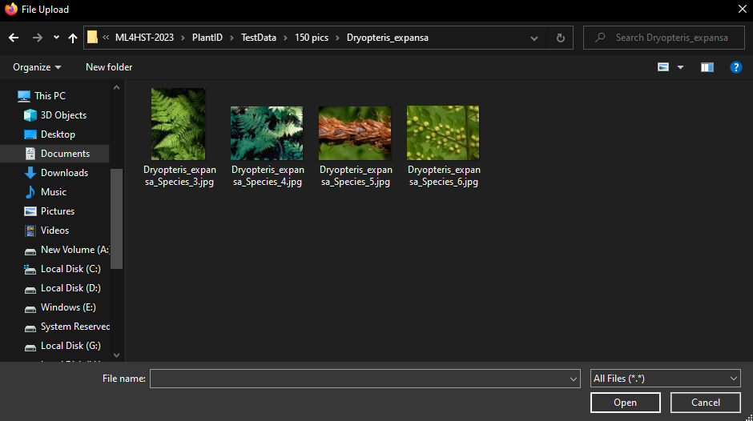
PlantNet
Select the image and click “Open”

Slide 39
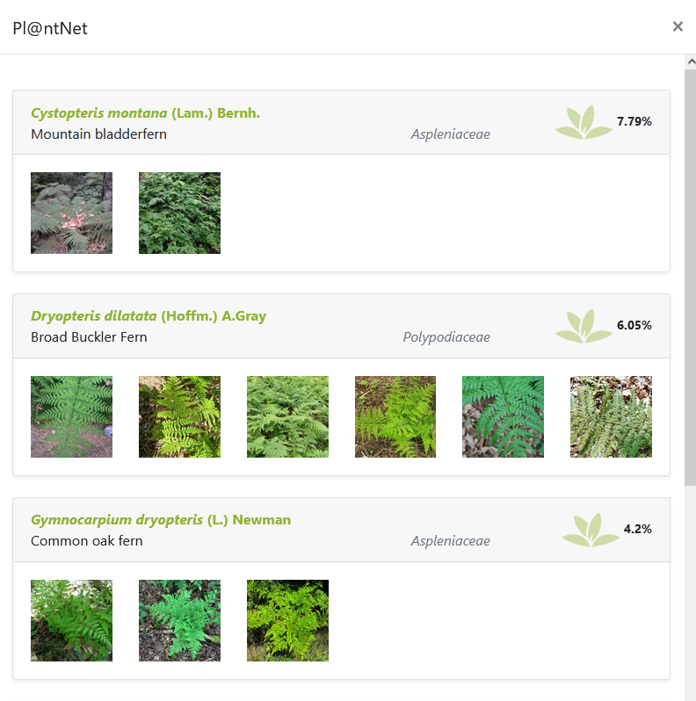
PlantNet
Once the analysis is complete, you should see a similar screen as below, showing the most likely species of the plant in the image

Slide 40
PlantNet
Spend time uploading each photo you brought in
Note down what mostly likely species of each plant is
If you knew the species of the plant, is the model correct?
The better the image, the more likely the model should be able to identify the plant

Slide 41
What was learned?
Data is important
The more data you have, the more classes you can have
However, the more data, the longer the training will be to get a good model
The model will also increase dramatically in complexity

Slide 42
Other Links
PlantNet iPhone App
https://apps.apple.com/fr/app/plantnet/id600547573
PlantNet Android App
https://play.google.com/store/apps/details?id=org.plantnet

